Slide 1
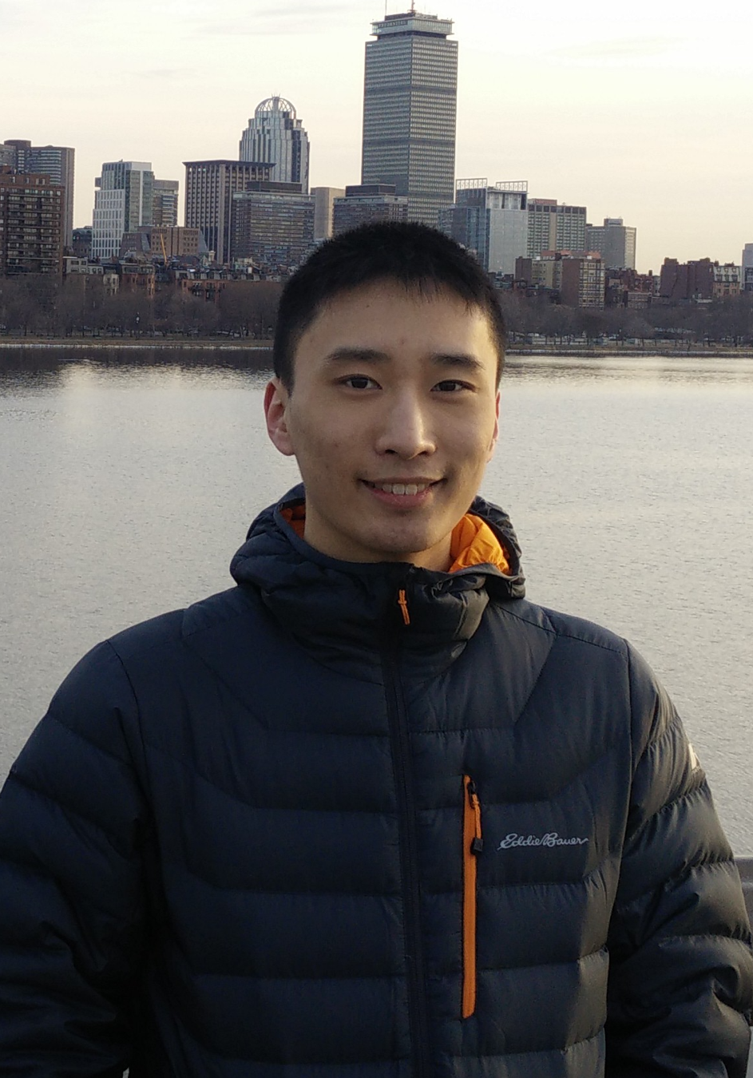






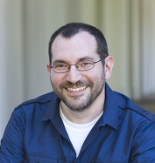

Learning Space Partitions for Path Planning
Kevin Yang*¹, Tianjun Zhang*¹, Chris Cummins², Brandon Cui², Benoit Steiner²,
Linnan Wang³, Joseph E. Gonzalez¹, Dan Klein¹, Yuandong Tian²
¹UC Berkeley ²Facebook AI Research ³Brown University

Slide 2
Overview
Background: Path Planning
Method: Latent Space Partitions for Path Planning
Theory: Why Space Partitioning?
Practice: Experimental Results

Slide 3
Overview
Background: Path Planning
Method: Latent Space Partitions for Path Planning
Theory: Why Space Partitioning?
Practice: Experimental Results

Slide 4
Overview
Background: Path Planning
Method: Latent Space Partitions for Path Planning
Theory: Why Space Partitioning?
Practice: Experimental Results

Slide 5
Overview
Background: Path Planning
Method: Latent Space Partitions for Path Planning
Theory: Why Space Partitioning?
Practice: Experimental Results

Slide 6
Overview
Background: Path Planning
Method: Latent Space Partitions for Path Planning
Theory: Why Space Partitioning?
Practice: Experimental Results

Slide 7
Overview
Background: Path Planning
Method: Latent Space Partitions for Path Planning
Theory: Why Space Partitioning?
Practice: Experimental Results

Slide 8
Path Planning

Slide 9
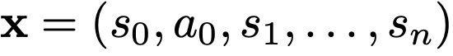

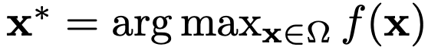
Path Planning
Goal: find the best path (e.g., state-action sequences in space ) :

Slide 10
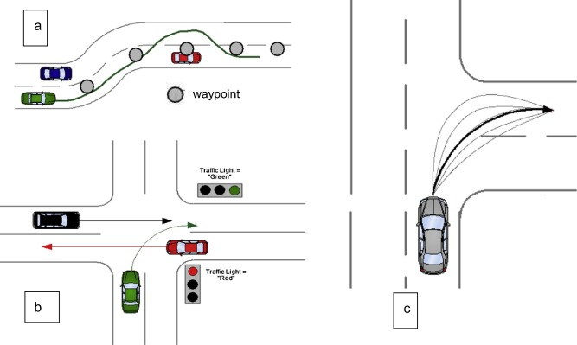
Path Planning
Goal: find the best path (e.g., state-action sequences in space ) :

Slide 11
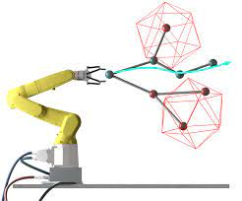
Path Planning
Goal: find the best path (e.g., state-action sequences in space ) :

Slide 12
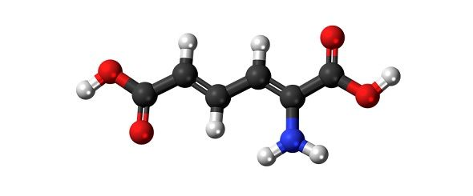
Path Planning
Goal: find the best path (e.g., state-action sequences in space ) :

Slide 13
Example: 2D Navigation
Notes:
Running example, since it makes intuitions clear

Slide 14
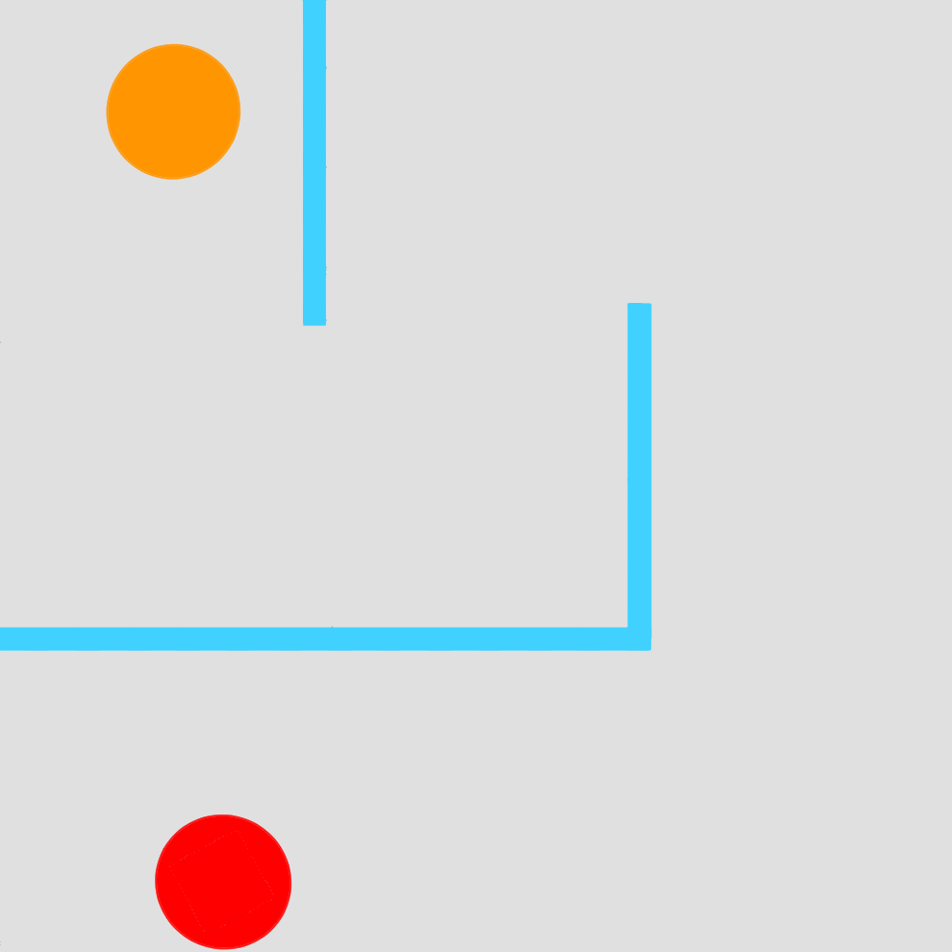
Example: 2D Navigation
Start
Goal
Notes:
Running example, since it makes intuitions clear

Slide 15
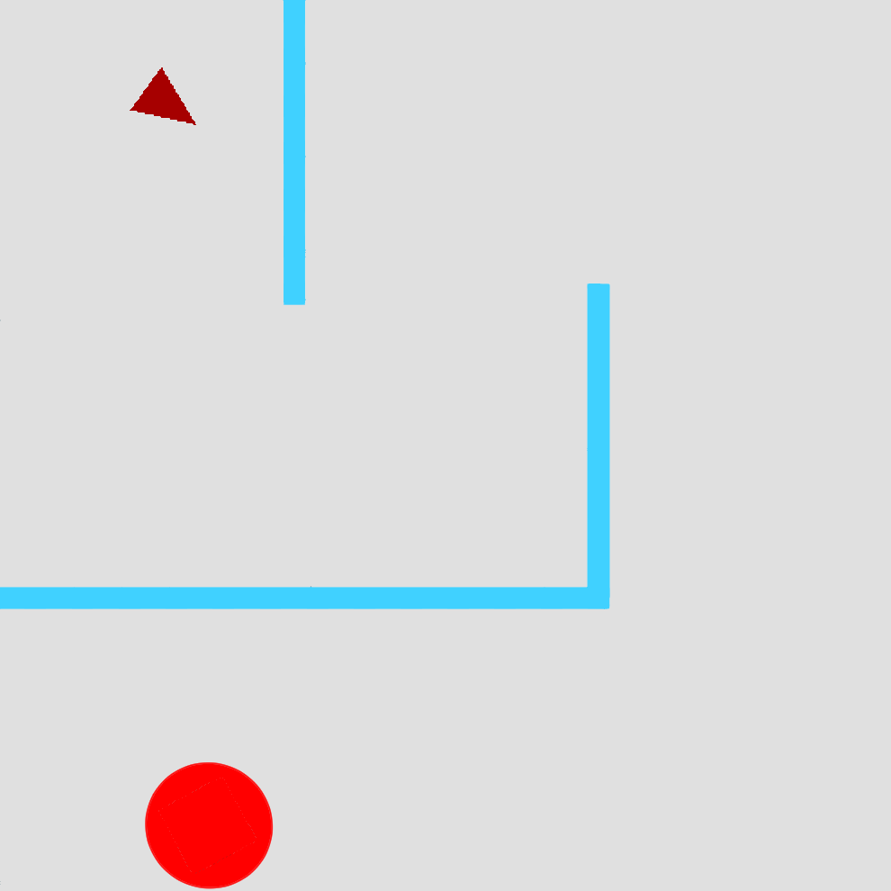
Example: 2D Navigation
Start
Goal
Notes:
Running example, since it makes intuitions clear

Slide 16
Example: 2D Navigation
Sparse reward: Euclidean distance to goal, with bonus for reaching goal
Start
Goal
Notes:
Running example, since it makes intuitions clear

Slide 17
Example: 2D Navigation
Sparse reward: Euclidean distance to goal, with bonus for reaching goal Continuous actions, open-loop planning; raw image states
Start
Goal
Notes:
Running example, since it makes intuitions clear

Slide 18
Example: 2D Navigation
Sparse reward: Euclidean distance to goal, with bonus for reaching goal Continuous actions, open-loop planning; raw image states
Up to 216 steps → 432-dim optimization problem!
Start
Goal
Notes:
Running example, since it makes intuitions clear

Slide 19
Example: 2D Navigation
Sparse reward: Euclidean distance to goal, with bonus for reaching goal Continuous actions, open-loop planning; raw image states
Up to 216 steps → 432-dim optimization problem!
Start
Goal
Random search
Notes:
Running example, since it makes intuitions clear

Slide 20
Example: 2D Navigation
Sparse reward: Euclidean distance to goal, with bonus for reaching goal Continuous actions, open-loop planning; raw image states
Up to 216 steps → 432-dim optimization problem!
Start
Goal
Random search
Notes:
Running example, since it makes intuitions clear

Slide 21
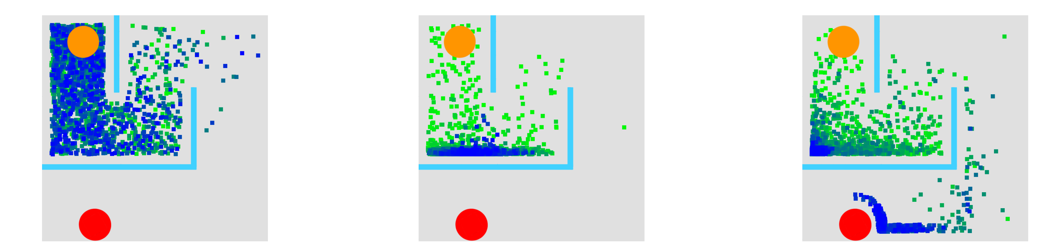
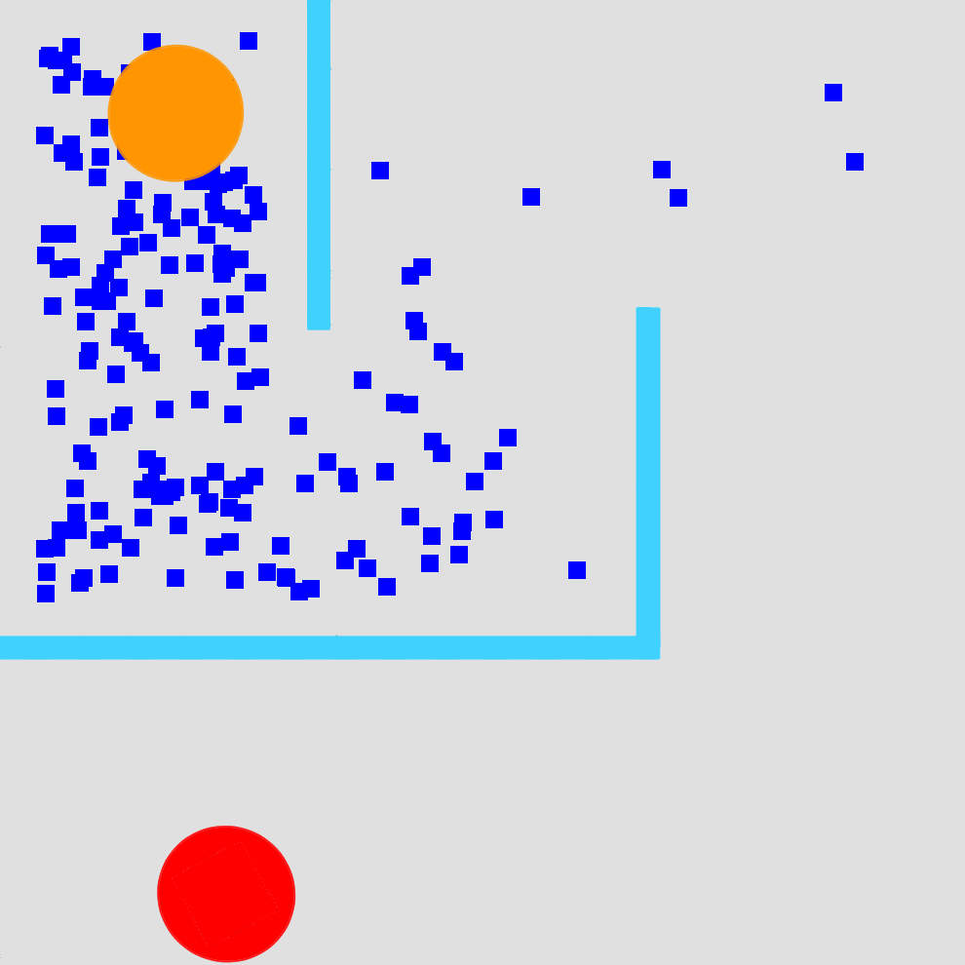
Example: 2D Navigation
Sparse reward: Euclidean distance to goal, with bonus for reaching goal Continuous actions, open-loop planning; raw image states
Up to 216 steps → 432-dim optimization problem!
Start
Goal
Random search

Slide 22
Example: 2D Navigation
Sparse reward: Euclidean distance to goal, with bonus for reaching goal Continuous actions, open-loop planning; raw image states
Up to 216 steps → 432-dim optimization problem!
Start
Goal
Random search
Random search is inefficient

Slide 23
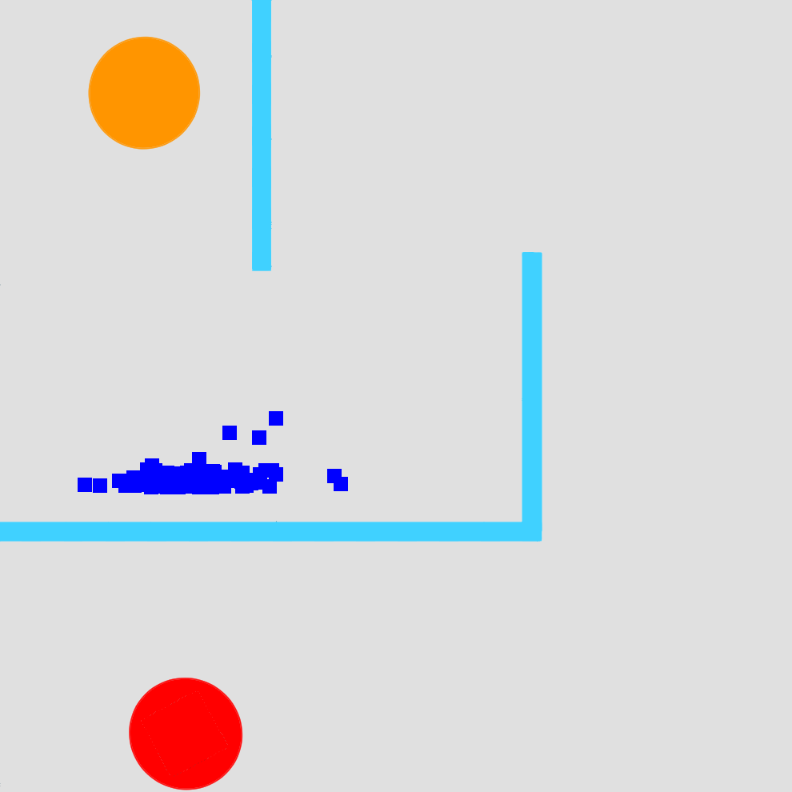
Example: 2D Navigation
Sparse reward: Euclidean distance to goal, with bonus for reaching goal Continuous actions, open-loop planning; raw image states
Up to 216 steps → 432-dim optimization problem!
Start
Goal
Random search
CEM
LaP³ (ours)
Random search is inefficient
Our approach,
Latent Partitions for Path Planning,
is much more efficient

Slide 24
Example: 2D Navigation
Sparse reward: Euclidean distance to goal, with bonus for reaching goal Continuous actions, open-loop planning; raw image states
Up to 216 steps → 432-dim optimization problem!
Start
Goal
Random search
CEM
LaP³ (ours)
Random search is inefficient
Local search methods
get stuck in local optima
Our approach,
Latent Partitions for Path Planning,
is much more efficient

Slide 25
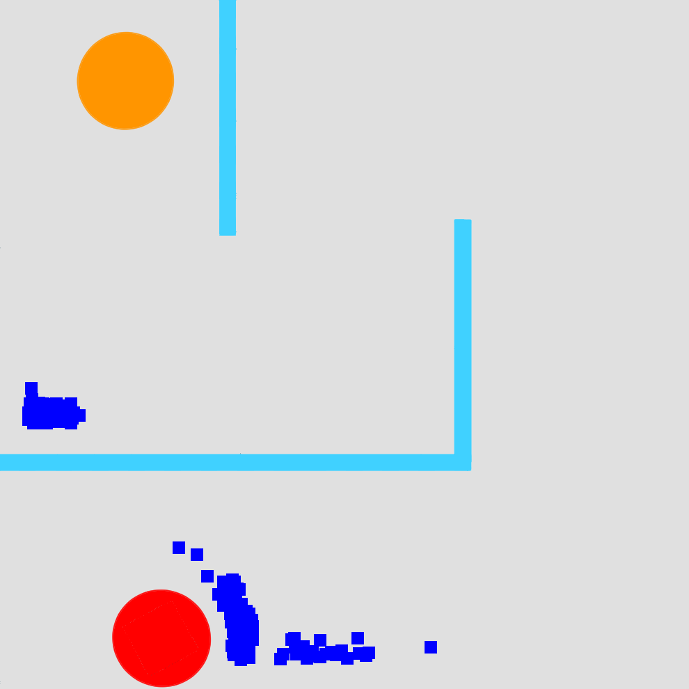
Example: 2D Navigation
Sparse reward: Euclidean distance to goal, with bonus for reaching goal Continuous actions, open-loop planning; raw image states
Up to 216 steps → 432-dim optimization problem!
Start
Goal
Random search
CEM
LaP³ (ours)
Random search is inefficient
Local search methods
get stuck in local optima

Slide 26
Example: 2D Navigation
Sparse reward: Euclidean distance to goal, with bonus for reaching goal Continuous actions, open-loop planning; raw image states
Up to 216 steps → 432-dim optimization problem!
Start
Goal
Random search
CEM
LaP³ (ours)
Random search is inefficient
Local search methods
get stuck in local optima
Our approach,
Latent Space Partitions for Path Planning,
is better at exploring

Slide 27
Overview
Background: Path Planning
Method: Latent Space Partitions for Path Planning
Theory: Why Space Partitioning?
Practice: Experimental Results

Slide 28
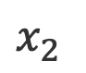
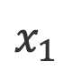
Algorithm Sketch
LaP³ is a black-box optimization meta-algorithm that repeats:
1. Partition:
2. Region Selection:
3. Local Sample:
$$x_{2}$$
$$x_{1}$$
“left”
“right”

Slide 29
Algorithm Sketch
LaP³ is a black-box optimization meta-algorithm that repeats:
1. Partition:
2. Region Selection:
3. Local Sample:
$$x_{2}$$
$$x_{1}$$
“left”
“right”

Slide 30
Algorithm Sketch
LaP³ is a black-box optimization meta-algorithm that repeats:
1. Partition:
2. Region Selection:
3. Local Sample:
$$x_{2}$$
$$x_{1}$$
“left”
“right”

Slide 31
Algorithm Sketch
LaP³ is a black-box optimization meta-algorithm that repeats:
1. Partition:
2. Region Selection:
3. Local Sample:
$$x_{2}$$
$$x_{1}$$
“left”
“right”

Slide 32
Algorithm Sketch
LaP³ is a black-box optimization meta-algorithm that repeats:
1. Partition:
2. Region Selection:
3. Local Sample:
$$x_{2}$$
$$x_{1}$$
“left”
“right”

Slide 33
Algorithm Sketch
LaP³ is a black-box optimization meta-algorithm that repeats:
1. Partition:
2. Region Selection:
3. Local Sample:
$$x_{2}$$
$$x_{1}$$
“left”
“right”

Slide 34
A Partition Tree Over Regions
Notes:
Emphasize learned partitions

Slide 35
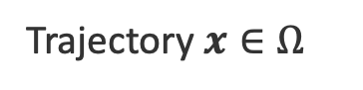

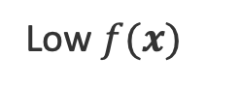
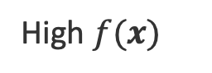
A Partition Tree Over Regions
Trajectory $x∈Ω$
Low $f(x)$
High $f(x)$
Search Space $Ω$
Notes:
Emphasize learned partitions

Slide 36
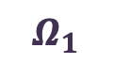
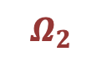
A Partition Tree Over Regions
Trajectory $x∈Ω$
$$Ω_{1}$$
$$Ω_{2}$$
Low $f(x)$
High $f(x)$
Search Space $Ω$
Space partition
Notes:
Emphasize learned partitions

Slide 37
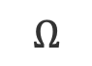
A Partition Tree Over Regions
Trajectory $x∈Ω$
Root
$$Ω$$
Low $f(x)$
High $f(x)$
Search Space $Ω$
Notes:
Emphasize learned partitions

Slide 38
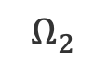
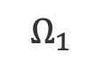
A Partition Tree Over Regions
Trajectory $x∈Ω$
Root
$$Ω_{1}$$
$$Ω_{2}$$
$$Ω$$
Low $f(x)$
$$Ω_{1}$$
$$Ω_{2}$$
High $f(x)$
Search Space $Ω$
Space partition
Notes:
Emphasize learned partitions

Slide 39
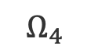
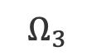
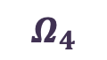
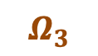
A Partition Tree Over Regions
Trajectory $x∈Ω$
Root
$$Ω_{3}$$
$$Ω_{2}$$
$$Ω$$
Low $f(x)$
$$Ω_{1}$$
$$Ω_{2}$$
High $f(x)$
$$Ω_{4}$$
Search Space $Ω$
$$Ω_{3}$$
$$Ω_{4}$$
Space partition
Notes:
Emphasize learned partitions

Slide 40
What Exactly to Partition?

Slide 41
What Exactly to Partition?
2D maze navigation: 216 (x,y) steps → 432-dim optimization
432-dim action sequence. What if we use states?
Intuition: intermediate actions aren’t very informative, but intermediate states are better
Start
Goal

Slide 42
What Exactly to Partition?
2D maze navigation: 216 (x,y) steps → 432-dim optimization
432-dim action sequence. What if we use states?
Intuition: intermediate actions aren’t very informative, but intermediate states are better
Start
Goal

Slide 43
What Exactly to Partition?
2D maze navigation: 216 (x,y) steps → 432-dim optimization
432-dim action sequence. What if we use states?
Intuition: intermediate actions aren’t very informative, but intermediate states are better
Start
Goal

Slide 44
What Exactly to Partition?
2D maze navigation: 216 (x,y) steps → 432-dim optimization
432-dim action sequence. What if we use states?
Intuition: intermediate actions aren’t very informative, but intermediate states are better
Start
Goal

Slide 45
Partitions Over Latent States
Problem: the “state” is huge! 216 steps x 14400-dim image…
No decoder needed!
Start
Latent Representation
Goal

Slide 46
Partitions Over Latent States
Problem: the “state” is huge! 216 steps x 14400-dim image…
No decoder needed!
Start
Latent Representation
Goal

Slide 47
Partitions Over Latent States
Problem: the “state” is huge! 216 steps x 14400-dim image…
No decoder needed!
Start
Latent Representation
Goal

Slide 48
Latent Partitions in Practice
Success rate over different mazes
LaP³
57%
LaP³ without latent partitioning
27%
Similar trend on other tasks / domains

Slide 49
Algorithm Sketch
LaP³ is a black-box optimization meta-algorithm that repeats:
1. Partition:
2. Region Selection:
3. Local Sample:
$$x_{2}$$
$$x_{1}$$
“left”
“right”

Slide 50
Selecting a Region
Trajectory $x∈Ω$
Root
$$Ω_{3}$$
$$Ω_{2}$$
$$Ω$$
Low $f(x)$
$$Ω_{1}$$
$$Ω_{2}$$
High $f(x)$
$$Ω_{4}$$
Search Space $Ω$
$$Ω_{3}$$
$$Ω_{4}$$
Space partition
Notes:
Emphasize learned partitions

Slide 51
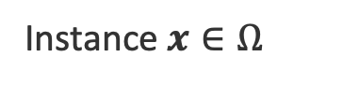
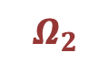
Selecting a Region
Instance $x∈Ω$
Root
$$Ω_{3}$$
$$Ω_{2}$$
$$Ω$$
Low $f(x)$
$$Ω_{1}$$
$$Ω_{2}$$
High $f(x)$
$$Ω_{4}$$
Search Space $Ω$
$$Ω_{3}$$
$$Ω_{4}$$
Space partition
Notes:
Emphasize learned partitions

Slide 52
Selecting a Region
Monte Carlo Tree Search
Instance $x∈Ω$
Root
$$Ω_{3}$$
$$Ω_{2}$$
$$Ω$$
Low $f(x)$
Good
action
Bad
action
$$Ω_{1}$$
$$Ω_{2}$$
Good
action
Bad
action
High $f(x)$
Exploitation
$$Ω_{4}$$
Search Space $Ω$
$$Ω_{3}$$
$$Ω_{4}$$
Exploration
Space partition
Notes:
Emphasize learned partitions

Slide 53
Selecting a Region
Monte Carlo Tree Search
Upper confidence bound (UCB)
Prefer less-visited nodes (explore)
Prefer higher values (exploit)
Important! How to define “higher”?
Mean vs Max
Root
$$Ω$$
Good
action
Bad
action
$$Ω_{1}$$
$$Ω_{2}$$
Good
action
Bad
action
Exploitation
$$Ω_{3}$$
$$Ω_{4}$$
Exploration
Notes:
Emphasize learned partitions

Slide 54
Selecting a Region
Monte Carlo Tree Search
Upper confidence bound (UCB)
Prefer less-visited nodes (explore)
Prefer higher values (exploit)
Important! How to define “higher”?
Mean vs Max
Root
$$Ω$$
Good
action
Bad
action
$$Ω_{1}$$
$$Ω_{2}$$
Good
action
Bad
action
Exploitation
$$Ω_{3}$$
$$Ω_{4}$$
Exploration
Notes:
Emphasize learned partitions

Slide 55
Selecting a Region
Monte Carlo Tree Search
Upper confidence bound (UCB)
Prefer less-visited nodes (explore)
Prefer higher values (exploit)
Important! How to define “higher”?
Mean vs Max
Root
$$Ω$$
Good
action
Bad
action
$$Ω_{1}$$
$$Ω_{2}$$
Good
action
Bad
action
Exploitation
$$Ω_{3}$$
$$Ω_{4}$$
Exploration
Notes:
Emphasize learned partitions

Slide 56
Selecting a Region
Monte Carlo Tree Search
Upper confidence bound (UCB)
Prefer less-visited nodes (explore)
Prefer higher values (exploit)
Important! How to define “higher”?
Mean vs Max
Root
$$Ω$$
Good
action
Bad
action
$$Ω_{1}$$
$$Ω_{2}$$
Good
action
Bad
action
Exploitation
$$Ω_{3}$$
$$Ω_{4}$$
Exploration
Notes:
Emphasize learned partitions

Slide 57
Selecting a Region
Monte Carlo Tree Search
Upper confidence bound (UCB)
Prefer less-visited nodes (explore)
Prefer higher values (exploit)
Important! How to define “higher”?
Mean vs Max
Root
$$Ω$$
Good
action
Bad
action
$$Ω_{1}$$
$$Ω_{2}$$
Good
action
Bad
action
Exploitation
$$Ω_{3}$$
$$Ω_{4}$$
Exploration
Notes:
Emphasize prev work used the wrong obvious choice

Slide 58
UCB Metric in Practice
Success rate over different mazes
LaP³
57%
LaP³ using mean metric
43%
Similar trend on other tasks / domains

Slide 59
Algorithm Sketch
LaP³ is a black-box optimization meta-algorithm that repeats:
1. Partition:
2. Region Selection:
3. Local Sample:
$$x_{2}$$
$$x_{1}$$
“left”
“right”

Slide 60
Sampling From a Leaf Region
Trajectory $x∈Ω$
Root
$$Ω_{3}$$
$$Ω_{2}$$
$$Ω$$
Low $f(x)$
Good
action
Bad
action
$$Ω_{1}$$
$$Ω_{2}$$
Good
action
Bad
action
High $f(x)$
Exploitation
$$Ω_{4}$$
Search Space $Ω$
$$Ω_{3}$$
$$Ω_{4}$$
Exploration
Space partition
Notes:
Emphasize learned partitions

Slide 61
Sampling From a Leaf Region
Trajectory $x∈Ω$
Root
$$Ω_{3}$$
$$Ω_{2}$$
$$Ω$$
Low $f(x)$
Good
action
Bad
action
$$Ω_{1}$$
$$Ω_{2}$$
Good
action
Bad
action
High $f(x)$
Exploitation
$$Ω_{4}$$
Search Space $Ω$
$$Ω_{3}$$
$$Ω_{4}$$
Exploration
Space partition
Notes:
Emphasize learned partitions

Slide 62
Sampling From a Leaf Region
Trajectory $x∈Ω$
Root
$$Ω_{3}$$
$$Ω_{2}$$
$$Ω$$
Low $f(x)$
Good
action
Bad
action
$$Ω_{1}$$
$$Ω_{2}$$
Good
action
Bad
action
High $f(x)$
Exploitation
$$Ω_{4}$$
Search Space $Ω$
$$Ω_{3}$$
$$Ω_{4}$$
Exploration
Space partition
Notes:
Emphasize learned partitions

Slide 63
Sampling From a Leaf Region
LaP³ is a meta-algorithm:
Use any existing solver, initialized with previous samples from selected leaf region
Trajectory $x∈Ω$
Root
$$Ω_{3}$$
$$Ω_{2}$$
$$Ω$$
Low $f(x)$
Good
action
Bad
action
$$Ω_{1}$$
$$Ω_{2}$$
Good
action
Bad
action
High $f(x)$
Exploitation
$$Ω_{4}$$
Search Space $Ω$
$$Ω_{3}$$
$$Ω_{4}$$
Exploration
Space partition
Notes:
Just outsource it

Slide 64
Improving the Local Solver
Success rate over different mazes
LaP³ (CMA-ES leaf solver)
57%
CMA-ES
24%
Similar trend on other tasks / domains

Slide 65
Overview
Background: Path Planning
Method: Latent Space Partitions for Path Planning
Theory: Why Space Partitioning?
Practice: Experimental Results

Slide 66
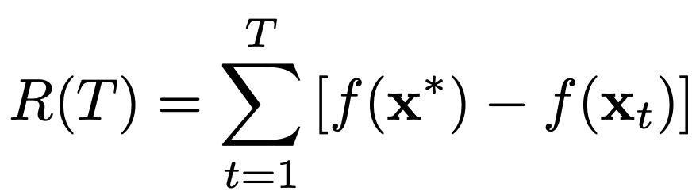
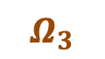
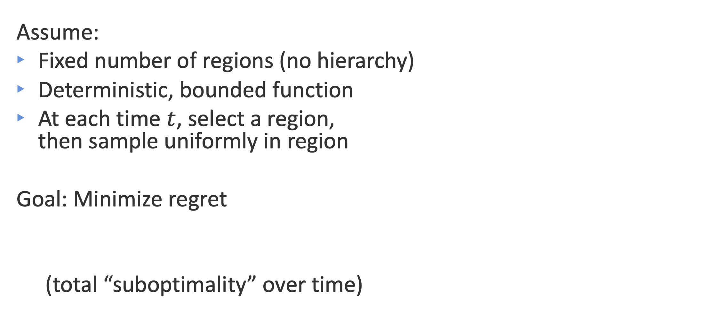
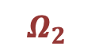


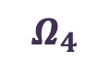
Setup for Analysis
Assume:
Fixed number of regions (no hierarchy)
Deterministic, bounded function
At each time $t$, select a region, then sample uniformly in region
Goal: Minimize regret
(total “suboptimality” over time)
Trajectory $x∈Ω$
$$Ω_{3}$$
$$Ω_{2}$$
$$Ω_{4}$$
Search Space $Ω$
Space partition

Slide 67
Setup for Analysis
Assume:
Fixed number of regions (no hierarchy)
Deterministic, bounded function
At each time $t$, select a region, then sample uniformly in region
Goal: Minimize regret
(total “suboptimality” over time)
Trajectory $x∈Ω$
$$Ω_{3}$$
$$Ω_{2}$$
$$Ω_{4}$$
Search Space $Ω$
Space partition

Slide 68
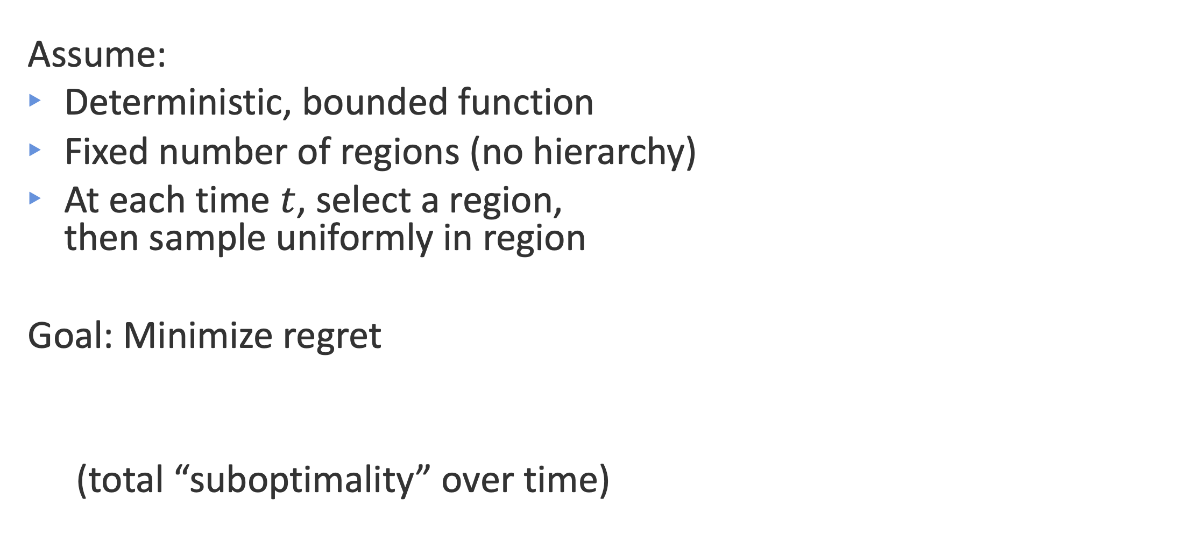
Setup for Analysis
Assume:
Deterministic, bounded function
Fixed number of regions (no hierarchy)
At each time $t$, select a region, then sample uniformly in region
Goal: Minimize regret
(total “suboptimality” over time)
Trajectory $x∈Ω$
$$Ω_{3}$$
$$Ω_{2}$$
$$Ω_{4}$$
Search Space $Ω$
Space partition

Slide 69
Setup for Analysis
Assume:
Deterministic, bounded function
Fixed number of regions (no hierarchy)
At each time $t$, select a region, then sample uniformly in region
Goal: Minimize regret
(total “suboptimality” over time)
Trajectory $x∈Ω$
$$Ω_{3}$$
$$Ω_{2}$$
$$Ω_{4}$$
Search Space $Ω$
Space partition

Slide 70
Setup for Analysis
Assume:
Deterministic, bounded function
Fixed number of regions (no hierarchy)
At each time $t$, select a region, then sample uniformly in region
Goal: Minimize regret
(total “suboptimality” over time)
Trajectory $x∈Ω$
$$Ω_{3}$$
$$Ω_{2}$$
$$Ω_{4}$$
Search Space $Ω$
Space partition

Slide 71
Setup for Analysis
Assume:
Deterministic, bounded function
Fixed number of regions (no hierarchy)
At each time $t$, select a region, then sample uniformly in region
Goal: Minimize regret
(total “suboptimality” over time)
Trajectory $x∈Ω$
$$Ω_{3}$$
$$Ω_{2}$$
$$Ω_{4}$$
Search Space $Ω$
Space partition
Space partition

Slide 72
Setup for Analysis
Assume:
Deterministic, bounded function
Fixed number of regions (no hierarchy)
At each time $t$, select a region, then sample uniformly in region
Goal: Minimize regret
(total “suboptimality” over time)
Trajectory $x∈Ω$
$$Ω_{3}$$
$$Ω_{2}$$
$$Ω_{4}$$
Search Space $Ω$
Space partition

Slide 73
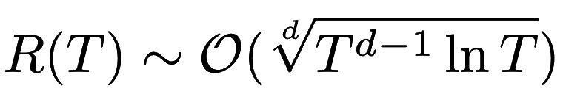
Sketch of Main Theorem
Theorem 1
Ialues within each region “sufficiently concentrated”
Select regions according to UCB based on max value in region
Then:
Total regret is sublinear:

Slide 74
Sketch of Main Theorem
Theorem 1
If:
Values within each region “sufficiently concentrated”
Select regions according to UCB based on max value in region
Then:
Total regret is sublinear:

Slide 75
Sketch of Main Theorem
Theorem 1
If:
Values within each region “sufficiently concentrated”
Select regions according to UCB based on max value in region
Then:
Total regret is sublinear:

Slide 76
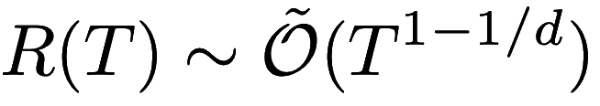
Sketch of Main Theorem
Theorem 1
If:
Values within each region “sufficiently concentrated”
Select regions according to UCB based on max value in region
Then:
Total regret is sublinear:

Slide 77
Implications: Region “Goodness”
Theorem 1
If:
Values within each region “sufficiently concentrated”
Select regions according to UCB based on max value in region
Then:
Total regret is sublinear:

Slide 78
Implications: Region “Goodness”
Theorem 1
If:
Values within each region “sufficiently concentrated”
Select regions according to UCB based on max value in region
Then:
Total regret is sublinear:
During MCTS, evaluate node quality by max value, not mean

Slide 79
Implications: Latent Partitions
Theorem 1
If:
Values within each region “sufficiently concentrated”
Select regions according to UCB based on max value in region
Then:
Total regret is sublinear:

Slide 80
Implications: Latent Partitions
Theorem 1
If:
Values within each region “sufficiently concentrated”
Select regions according to UCB based on max value in region
Then:
Total regret is sublinear:
Lower-dimensional latent space can be more sample-efficient

Slide 81
Implications: Learned Partitions
Theorem 1
If:
Values within each region “sufficiently concentrated”
Select regions according to UCB based on max value in region
Then:
Total regret is sublinear:
How to get sufficiently concentrated values?
Need to learn partitions based on function values, rather than partitioning randomly

Slide 82
Implications: Learned Partitions
Theorem 1
If:
Values within each region “sufficiently concentrated”
Select regions according to UCB based on max value in region
Then:
Total regret is sublinear:
How to get sufficiently concentrated values?
Need to learn partitions based on function values, rather than partitioning randomly

Slide 83
Implications: Learned Partitions
Theorem 1
If:
Values within each region “sufficiently concentrated”
Select regions according to UCB based on max value in region
Then:
Total regret is sublinear:
How to get sufficiently concentrated values?
Need to learn partitions based on function values, rather than partitioning randomly

Slide 84
Implications: Recursive Partitioning
Theorem 1
If:
Values within each region “sufficiently concentrated”
Select regions according to UCB based on max value in region
Then:
Total regret is sublinear:

Slide 85
Implications: Recursive Partitioning
Theorem 1
If:
Values within each region “sufficiently concentrated”
Select regions according to UCB based on max value in region
Then:
Total regret is sublinear:
Problem: Definition of “sufficiently” scales with …
Solution: Don’t keep the regions fixed! Need to keep partitioning more over time, for more “concentrated” values

Slide 86
Implications: Recursive Partitioning
Theorem 1
If:
Values within each region “sufficiently concentrated”
Select regions according to UCB based on max value in region
Then:
Total regret is sublinear:
Problem: Definition of “sufficiently” scales with …
Solution: Don’t keep the regions fixed! Need to keep partitioning more over time, for more “concentrated” values

Slide 87
Overview
Background: Path Planning
Method: Latent Space Partitions for Path Planning
Theory: Why Space Partitioning?
Practice: Experimental Results

Slide 88
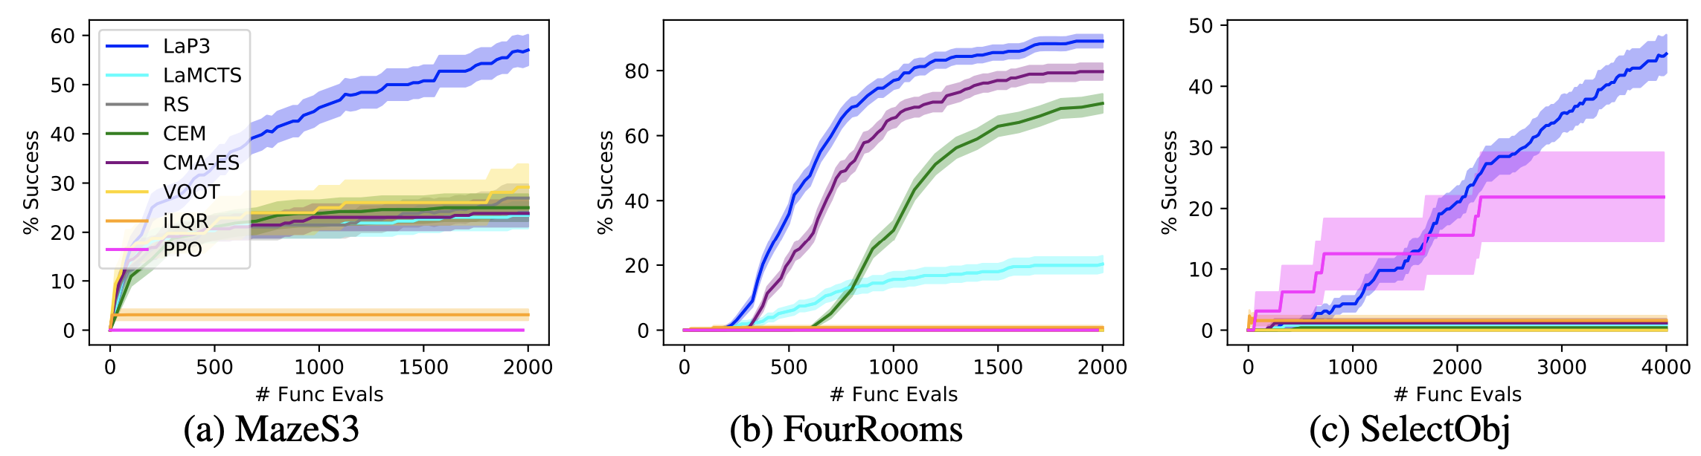
Experiments: 2D Navigation
MazeS3: Running example, navigating a maze.
FourRooms: Four rooms in a square connected by doors; navigate to goal in diagonally opposite room.
SelectObj: Two possible goals; farther goal has higher reward. Success defined as reaching far goal.

Slide 89
Experiments: 2D Navigation
MazeS3
FourRooms
SelectObj
MazeS3: Running example, navigating a maze.

Slide 90
Experiments: 2D Navigation
MazeS3
FourRooms
MazeS3: Running example, navigating a maze.
FourRooms: Four rooms in a square connected by doors; navigate to goal in diagonally opposite room.

Slide 91
Experiments: 2D Navigation
MazeS3
FourRooms
SelectObj
MazeS3: Running example, navigating a maze.
FourRooms: Four rooms in a square connected by doors; navigate to goal in diagonally opposite room.
SelectObj: Two possible goals; farther goal has higher reward. Success defined as reaching far goal.

Slide 92
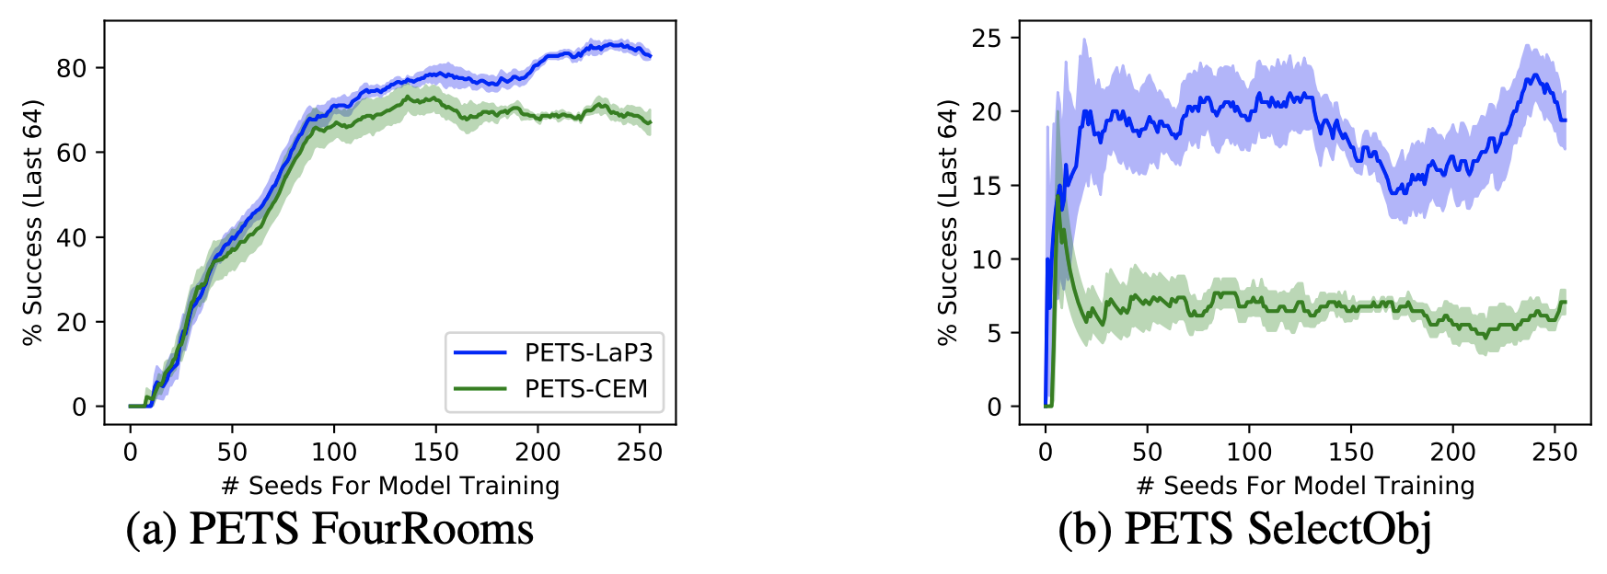
Experiments: 2D Navigation
LaP³ still works with a learned model (PETS) of environment dynamics

Slide 93
Experiments: 2D Navigation
LaP³ still works with a learned model (PETS) of environment dynamics
FourRooms
SelectObj
*MazeS3 task not run due to difficulties with learning a dynamics model; see paper

Slide 94
Experiments: 2D Navigation
LaP³ still works with a learned model (PETS) of environment dynamics
FourRooms
SelectObj
*MazeS3 task not run due to difficulties with learning a dynamics model; see paper

Slide 95
Experiments: Molecular Design

Slide 96
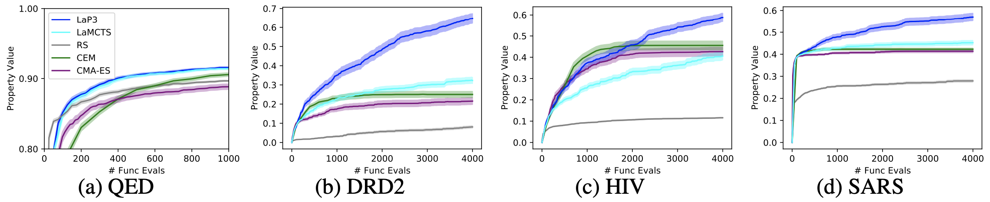
Experiments: Molecular Design
QED
DRD2
HIV
SARS
QED: a synthetic measure of drug-likeness (easy property)
DRD2: a measure of binding affinity to a human dopamine receptor
HIV: estimated inhibition probability for HIV
SARS: estimated inhibition probability for SARS

Slide 97
Experiments: Molecular Design
QED
DRD2
HIV
SARS
QED: a synthetic measure of drug-likeness (easy property)
DRD2: a measure of binding affinity to a human dopamine receptor
HIV: estimated inhibition probability for HIV
SARS: estimated inhibition probability for SARS

Slide 98
Experiments: Molecular Design
QED
DRD2
HIV
SARS
QED: a synthetic measure of drug-likeness (easy property)
DRD2: a measure of binding affinity to a human dopamine receptor
HIV: estimated inhibition probability for HIV
SARS: estimated inhibition probability for SARS

Slide 99
Experiments: Molecular Design
QED
DRD2
HIV
SARS
QED: a synthetic measure of drug-likeness (easy property)
DRD2: a measure of binding affinity to a human dopamine receptor
HIV: estimated inhibition probability for HIV
SARS: estimated inhibition probability for SARS

Slide 100
Experiments: Molecular Design
QED
DRD2
HIV
SARS
QED: a synthetic measure of drug-likeness (easy property)
DRD2: a measure of binding affinity to a human dopamine receptor
HIV: estimated inhibition probability for HIV
SARS: estimated inhibition probability for SARS
See paper for experiments on more 2D navigation environments, compiler phase ordering, synthetic functions

Slide 101
Takeaways
LaP³ is a meta-algorithm for black-box path planning which:
Repeatedly constructs a partition tree of regions, and samples from a leaf according to MCTS
Is designed according to theory
Partitions in a latent space
Uses the theoretically justified UCB metric
Substantially outperforms strong baselines across multiple diverse domains

Slide 102
Takeaways
LaP³ is a meta-algorithm for black-box path planning which:
Repeatedly constructs a partition tree of regions, and samples from a leaf according to MCTS
Is designed according to theory
Partitions in a latent space
Uses the theoretically justified UCB metric
Substantially outperforms strong baselines across multiple diverse domains

Slide 103
Takeaways
LaP³ is a meta-algorithm for black-box path planning which:
Repeatedly constructs a partition tree of regions, and samples from a leaf according to MCTS
Is designed according to theory
Partitions in a latent space
Uses the theoretically justified UCB metric
Substantially outperforms strong baselines across multiple diverse domains

Slide 104
Takeaways
LaP³ is a meta-algorithm for black-box path planning which:
Repeatedly constructs a partition tree of regions, and samples from a leaf according to MCTS
Is designed according to theory
Partitions in a latent space
Uses the theoretically justified UCB metric
Substantially outperforms strong baselines across multiple diverse domains

Slide 105
Takeaways
LaP³ is a meta-algorithm for black-box path planning which:
Repeatedly constructs a partition tree of regions, and samples from a leaf according to MCTS
Is designed according to theory
Partitions in a latent space
Uses the theoretically justified UCB metric
Substantially outperforms strong baselines across multiple diverse domains

Slide 106
Thanks!
Code: https://github.com/yangkevin2/neurips2021-lap3

